Slide 1
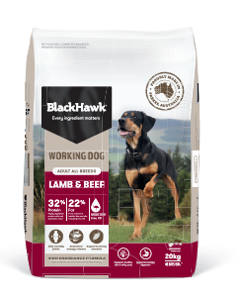
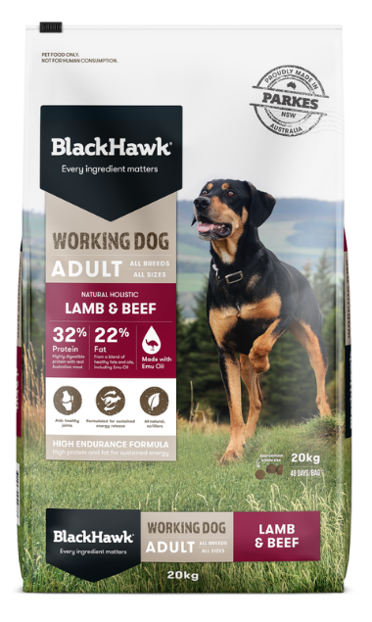
Black Hawk Working Dog 20kg
Packaging Refresh
Background information
Black Hawk Working Dog 20kg is a high endurance formula which is high in protein and fat that promotes sustained energy release. Strong lean muscles as well as healthy joints and coats
Rationale
A packaging refresh was implemented to strengthen shelf impact, improve clarity for shoppers, and better align with the Black Hawk range
Timings
Key Changes
Existing stock will flow through as normal
Stronger, more consistent branding
  Updated Black Hawk wordmark emphasizing Australian provenance
  Added colour band for better shelf standout and alignment with wider range
Clearer life stage branding
  Updated to “All life stages” claim
  Includes Large Breed puppies for clearer guidance
Improved On Pack Communication
  Introduction of key benefit claims on front of pack
What you need to know:
Soft change only with no operational impact
  No change in item code, barcode, pack size and dimensions or pallet configuration
Current Pack
Flowthrough: AU – Sept '26
FOR RETAILERS

Slide 2
Black Hawk Working Dog Product Update
Packaging Refresh
FOR EXTERNAL
For those who want detailed changes
Background information
Black Hawk Working Dog 20kg is a high endurance formula which is high in protein and fat that promotes sustained energy release. Strong lean muscles as well as healthy joints and coats
Rationale
A packaging refresh was implemented to strengthen shelf impact, improve clarity for shoppers, and better align with the Black Hawk range
Key Changes
Suitable for all life stages – A complete and balanced meal for all life stages and all breeds of dog. (Black Hawk Working is formulated to meet the nutritional levels established by the Association of American Feed Control Officials (AAFCO) Dog Food Nutrient Profiles for All Life Stages including for growth of large sized dogs (30kg or more as an adult). We have adjusted the ingredient proportions in the updated recipe to ensure nutrient levels, including calcium and phosphorus, are appropriate for growth and meet the nutritional needs of puppies.
Added hydrolysed chicken - digestible meat proteins support muscle recovery
Increased L carnitine - supplementary L-carnitine helps boost fat metabolism and maintain lean muscle mass.
Increased fish oil – supports healthy skin, shiny coat and joints. Omega-3 fatty acids also help support brain and cognitive development in puppies.
Increased glucosamine – helps support and maintain cartilage for healthier joints.
Added green-lipped mussel and increased supplementary chondroitin – designed to help support healthy joints
Added faba beans – a digestible plant protein, faba beans are also rich in fibre, which contributes to good intestinal health.
Current Pack
Flowthrough: AU – Sept '26
When transitioning between any diets, it’s important to do so slowly. Veterinarians usually recommend transitioning over 1-2 weeks (2 weeks is better), regardless of what diets you’re transitioning between. See pack for feeding transition instructions.

